Slide 1
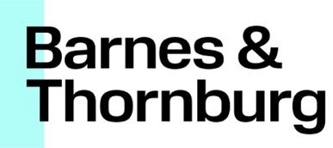
2024-2025 Export Controls & Sanctions Compliance Webcast Series
LAST UPDATED: March 2025
For any presentation involving BDO Consulting Group, please add the following below the BDO disclaimer (then adjust text box so it sits appropriately on page)
Restructuring and turnaround services within the United States are offered through BDO Consulting Group, LLC, a separate legal entity and affiliated company of BDO USA, P.C, a Virginia professional corporation. Certain restructuring and turnaround services may not be available to attest clients of BDO USA under the rules and regulations of public accounting.

Slide 2
Executing Compliance with Global Teams
LAST UPDATED: March 2025
For any presentation involving BDO Consulting Group, please add the following below the BDO disclaimer (then adjust text box so it sits appropriately on page)
Restructuring and turnaround services within the United States are offered through BDO Consulting Group, LLC, a separate legal entity and affiliated company of BDO USA, P.C, a Virginia professional corporation. Certain restructuring and turnaround services may not be available to attest clients of BDO USA under the rules and regulations of public accounting.
APRIL 17, 2025

Slide 3
With You Today
Linda Weinberg Partner International Trade Co-Chair Barnes & Thornburg 202-408-6902 linda.weinberg@btlaw.com | Pei Li wong Principal BDO USA, P.C. 212-885-8288 pwong@bdo.com | LEILEI WU Senior Manager BDO USA, P.C. 212-885-7307 lwu@bdo.com

Slide 4
Learning Objectives
Discuss opportunities and challenges in executing export control compliance programs by leveraging global teams.
Discuss strategies to effectively manage compliance workflows on a global scale, enhance coordination among international teams and ensure timely responses to compliance issues.
Discuss effective approaches for embedding elements of export control compliance into global operations.
Discuss strategies to monitor and implement frequent changes to export control regulations on a global basis.

Slide 5
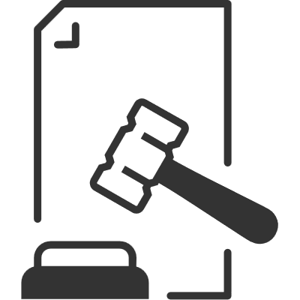
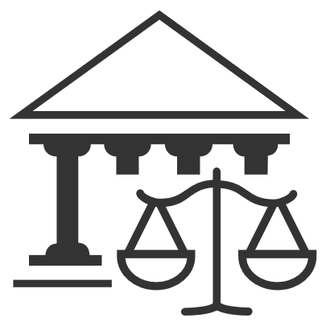
Challenges in Executing Export Control Compliance Programs with Global Teams
Rapidly changing regulatory requirements may lead to challenges in adjusting organization-wide compliance programs
Export-control status of items or entities change over time
1
Extraterritorial application of export control laws
U.S. export control laws are extraterritorial and extends to jurisdictions outside of the U.S.
Consider aspects of export control laws such as FDPR, deemed exports and diversion risks
2
Potential conflicts/inconsistencies in international regulatory requirements
Many countries have similar export controls to the U.S. (e.g., members of the Wassenaar arrangement), or have recently implemented export control laws
Implications of national security interests, trade wars and data privacy laws enacted by various countries
3

Slide 6
Challenges in Executing Export Control Compliance Programs with Global Teams
Barriers to cross-border communications that exist due to time zone and language differences, further complicated by the time-sensitive nature of communications between headquarters and local teams
4
5
Large and complex organizations may have antiquated and disparate systems, impacting efficiency and effectiveness
Other challenges arising from:
Cultural differences
Ambiguity in accountability between headquarter and local teams
6

Slide 7
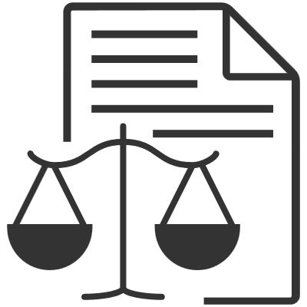
Best Practices in the Execution of Compliance Programs with Global Teams
Addressing regulatory challenges
Set up a “hub-and-spoke” system to better support compliance programs
Localize policies and ensure mechanisms are in place for updates
1
Knowing your business (and risks)
Adopt a risk-adjusted approach towards compliance
Integrate compliance into business processes
2
Setting Up Your Team for Success
Incorporate international and multi-disciplinary elements
Provide regular and timely training
Set up clear reporting lines and responsibilities
3

Slide 8
Best Practices in the Execution of Compliance Programs with Global Teams
Implementation and Monitoring
Ensure tone from the top is consistent with compliance goals
Implement channels for escalation of potential non-compliant behavior
Compliance team conducts regular on-site visits
4
Leverage Data and Technology
Consider application of data and technology in screening, monitoring and detection of anomalies and red flags
Important to regularly review the veracity of data
5
6
Other opportunities in the deployment of global teams

Slide 9
Concluding Thoughts

Slide 10
Survey Question
1 | Yes, I’d like to speak to a BDO or Barnes & Thornburg Professional
Would you like to speak with any of our presenters about the content in today’s webcast?
2 | No, not currently, thank you.

Slide 11
Thank You!

