Slide 1
The Road to Transition What 2023 and the Future Holds for the Natural Resources Industry
March 23, 2023

Slide 2
With You Today
Clark sackschewsky
Natural Resources National Practice Leader and Tax Principal, BDO USA
713-548-0899
csackschewsky@bdo.com

Slide 3
Agenda for Today
 | The State of the Economy on the Natural Resources Industry
 | Increasing Investment
 | Energy Markets, Financial Risk & Outlook
 | Evolving Tax Regulations
 | What’s Next: 2023 & Beyond

Slide 4
Historical Overview of Energy in the U.S.

Slide 5
HISTORICAL ENERGY PRODUCTION IN THE U.S. U.S. Energy Production by Source
Source: U.S. Energy Information Administration

Slide 6
HISTORICAL ENERGY PRODUCTION IN THE U.S. U.S. Energy Consumption by Source
Source: U.S. Energy Information Administration

Slide 7
Methodology
The 2023 BDO Energy CFO Outlook Survey polled 100 energy CFOs in oil & gas and renewables with revenues ranging from $250 million to over $3 billion in October 2022. The survey was conducted by Rabin Research Company, an independent marketing research firm, using Op4G’s panel of executives.

Slide 8
The State of Natural Resources

Slide 9
Profitability & Revenue

Slide 10
Increasing Investment
The Future is Looking Bright for Energy

Slide 11
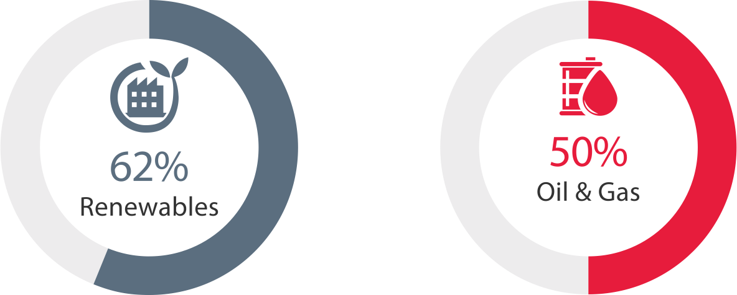
Investment Opportunities Abound
Availability of Borrowing Opportunities
Percentage of CFOs that expect to see borrowing opportunities increase
Keys for attracting capital in 2023
Strategic capital deployment
Continued operational success
Notes:
Why are energy CFOs so optimistic?
Increased optimism in the energy sector, due to practicing financial discipline over the past two years
New credits and incentives available in the Inflation Reduction Act (IRA)

Slide 12
Anticipated Borrowing Challenges
36%
REDUCTION IN BORROWING OPTIONS
36% of oil & gas and 30% of renewables CFOs are concerned they won’t have as many options to access capital in 2023.
of renewables CFOs report their top borrowing challenge in 2023 is rising costs
FULLY DRAWN ON CREDIT FACILITIES
Energy CFOs may need to seek alternative options to access capital when traditional borrowing is no longer possible.

Slide 13
Investment Plans in an Economic Downturn ENERGY CFOS WILL CONTINUE SPENDING
Notes:
Although we may avoid a recession, energy companies are cautiously optimistic about continuing to spend if the economy worsens.

Slide 14
Energy Markets
Financial Risk Landscape & Outlook

Slide 15
Stock Market Performance S&P 500 ENERGY (SECTOR)
Source: S&P Dow Jones Indices LLC

Slide 16
The Risk Landscape CFOS TOP SIGNIFICANT BUSINESS RISKS COMPARED TO 2022
2023
2022
Natural Disasters
56%
20%
25%
Supply Chain Disruption
51%
24%
Economic Volatility
46%
Notes:
With strong financial performance last year and anticipated continued revenue and profitability growth this year – CFOs seem to feel risks are less risky
While the data may indicate that organizations have taken steps to avert potential risks already – those that haven’t, should perform or revisit their risk assessments and determine any necessary steps to mitigate potential issues.
The rare mineral shortage is one example of an opportunity for energy companies to take preparedness steps.
While these critical resources are in high demand and short supply for everything from wind turbines, to solar panels, batteries and more, a proactive approach to supply chain management can help address potential issues.

Slide 17
Energy Companies Are Past the Recovery Phase
Both oil & gas and renewables CFO reported strong revenue and profitability growth over the past 12 months
76%
of oil & gas companies are thriving
60%
of renewables companies are thriving
Notes:
Energy companies performed relatively well last year – 68% of energy companies are thriving. Thriving companies are those that experienced both revenue and profitability growth over the past 12 months.

Slide 18
Evolving Tax Regulations
Financial Risk Landscape & Outlook

Slide 19
IRA Opportunities CFOS SHARE INFLATION REDUCTION ACT PLANS FOR THE NEXT 12 MONTHS
Just
of CFOs are concerned about the top tax implications of strategic business decisions
Assessing total tax liability
27%
Revisiting decarbonization plans
Notes:
Businesses may be missing the opportunity to align tax planning with strategic business decisions
This can mitigate risk, lead to tax efficiencies and uncover opportunities to optimize tax planning
Increasing tax transparency is also critical as regulations become more stringent -- and stakeholder interest increases

Slide 20
Top Barriers to IRA Credits
43%
37%
17%
Understanding the direct pay credit transfer system
Incorporating new credits and incentives into planning
Understanding how credits will impact TTL
Notes:
We expect 2023 to still have challenges, especially H1
Key concerns: high interest rates, high inflation, high inventory levels
Retailers’ main goals should be cost optimization – not cost cutting – and improving sell through
We expect consumer spending is going to be hard to predict
What does the landscape look like?
Record numbers of customers using buy now, pay later methods. 2023 will be the “pay later” portion and consumers are entering the year with high credit card debt.
High levels of consumer debt may further curb spending and impact retail sales.
High interest rates making it difficult for retailers – especially distressed retailers – to take on new debts that may need to either grow or stay afloat

Slide 21
What’s Next for Energy
2023 and Beyond

Slide 22
Historical U.S. WTI Oil Prices
Source: U.S. Energy Information Administration
Notes:
April 20, 2020 – negative oil price
July 14, 2008 - $145.00
December 19, 2008 - $33.87

Slide 23
Historical U.S. Natural Gas Pricing
Source: U.S. Energy Information Administration

Slide 24
Historical U.S. Electricity Pricing (per KWH)
Source: U.S. Bureau of Labor Statistics

Slide 25
Navigating the Future
FOCUS ON BUILDING RESILIENCE
Energy companies that embed tax into business strategy, reprioritize investments and develop a mature ESG program, can help shape the future of energy and fuel continued success for their business.
GET AHEAD OF GUIDANCE
Don’t wait for the final guidance from the Department of Commerce about the IRA or from the SEC and other federal regulators on ESG changes. Companies that plan ahead are in a better position to pivot if the guidance is slightly different than anticipated, rather than starting from scratch.
USE CHANGES AS COMPETITIVE ADVANTAGE
New credits and incentives can be used for new investments including digital transformation, capital projects, strengthening your workforce and more.

Slide 26
2023 BDO ENERGY CFO OUTLOOK SURVEY
See how energy compares to other industries:
2023 BDO Middle Market CFO Outlook Survey

Slide 27
Get to Know CLARK SACKSCHEWSKY Natural Resources National Practice Leader and Tax Principal
Clark is a Tax Principal for BDO’s Houston office and National Practice Leader in BDO's Natural Resources practice. Clark has more than 25 years of corporate tax experience in both public accounting and industry and has extensive experience serving clients in the natural resources industry, specifically oil and gas.
He has worked on hundreds of oil and gas transactions and has led over 50 different engagements for upstream, midstream, and downstream oil and gas clients including master limited partnerships (MLPs) and oilfield services companies. His broad experience includes ASC 740, U.S. federal and state tax planning, transfer pricing, and internal reorganizations.
713-548-0899
csackschewsky@bdo.com

